Slide 1
Airbnb – New user destination prediction
- Pranesh Narayanan

Slide 2
AGENDA
Introduction to AirBnB
Project Motivation/Background
Executive Summary
Data Profiling/Manipulation
Data-based Insights
Clustering
Predictive Modelling
Model Comparison
Conclusion
Business Significance

Slide 3

Introduction to airbnb
Online community marketplace for lodging
Connects people who have a place to “lend” with people who are looking for a place to stay
Users of AirBnB are typically hosts and travelers
AirBnB is a business where data is one of the primary driving forces because there are no physical AirBnB stores
Fast-growing community - 60 Million Users as on February 2016

Slide 4
Project motivation/background
AirBnB recently put out a challenge on kaggle.com where they provided a dataset and were interested in seeing as to where a new user was more likely to make their first reservations
The data provided contained demographic/background information of existing users and details of their first booking
I felt that a comparatively young business such as AirBnB that was giving conventional hotel chains a run for their money would have many insights for us to unearth from within the depths of their customer data
Hence I chose to work with this data.

Slide 5
Executive Summary
In this project, we tried to:
Visualize customer behavior and uncover hidden insights using Tableau
Highlight the importance of data manipulation, data munging using statistical modelling tools like R, SAS and SAS Miner.
Use predictive modelling to predict a new user’s first destination

Slide 6
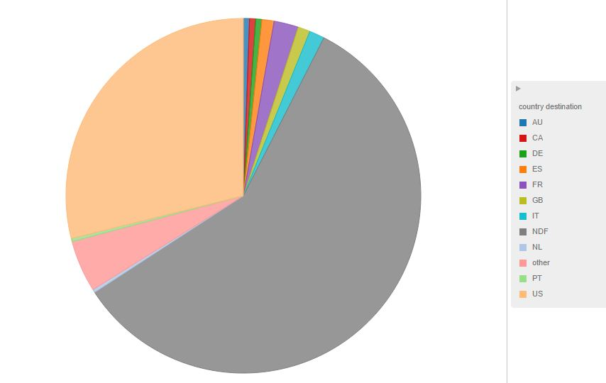
Data Description/Pre-processing
There were 4 different sheets provided with close to 2 Million records.
Target Variable - 12 outcomes – 'US', 'FR', 'CA', 'GB', 'ES', 'IT', 'PT', 'NL','DE', 'AU', 'NDF(No Booking Made)', OTHER (Country other than the provided).
Upon analyzing the data we found that there was a huge bias in the dataset among members who did not book tickets(NDF) and those members who preferred domestic travel within the US
Class imbalance

Slide 7
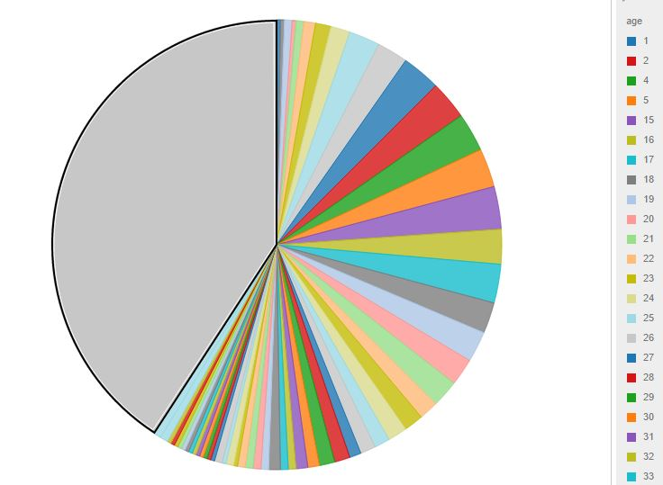
Data Description/Pre-processing
We also discovered that approximately 41% of customers did not have their age listed in the data set there were a lot of missing values in the age.
We believe that missing ages might not be accidental in most cases. We believe that since some people are conservative about providing such sensitive information they are Not Missing at Random(NMAR)

Slide 8
Data Description/Pre-processing
DERIVED VARIABLES:
TotSecs
TotSessions
Month_account_created
Date_account_created
Year_account_created
Month_first_Booking
Date_first_Booking
Year_first_Booking
Daysforbooking
BookingType
Notes:
TotSecs: Time spent on AirBnB before arriving at a destination decision.
TotSessions: This variable denotes the total number of sessions that user have accessed website. This was calculated in BaseSAS by performing the count operation of the number of records each user had on the sessions database. This variable helped us get an idea about how many individual sessions a user took to come to a decision about where their destination was.
Month_account_created: month the account was created
Date_account_created: day the account was created
Year_account_created: year the account was created
Month_first_Booking: month when the first booking was made
Date_first_Booking: day when the first booking was made
Year_first_Booking: year when the first booking was made
Daysforbooking : This variable denotes the number of days that the user takes for making a reservation. This variable tells us the time elapsed, in days, from the starting date of joining AirBnB to the date of first booking. This was calculated by using the above 6 derived variables in Base SAS.
BookingType: This variable indicates what kind of booking was made. Based on the value of the above derived variable we categorized the booking as Immediate, Quick, Normal or Not Booked. This variable gives us an idea about the customer’s nature viz. whether they are prone to impulsive decisions or slow and meticulously calculated decisions, with respect to travel. The SAS code snipped used for deriving this is posted below.

Slide 9
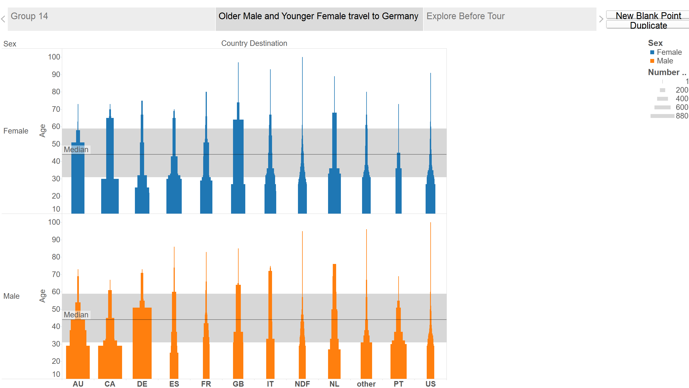
Data based insights - I
Notes:
Predicting Country Destination using Age and Gender
Around half the male population travelling to Australia is around 29 years old
While 90% of the female population travelling to Australia is 50 years old
Australia, Canada and Great Britain seem to be the popular holiday locations for 40 years or older females, while Germany is the population holiday destination for Males 40 year or older

Slide 10
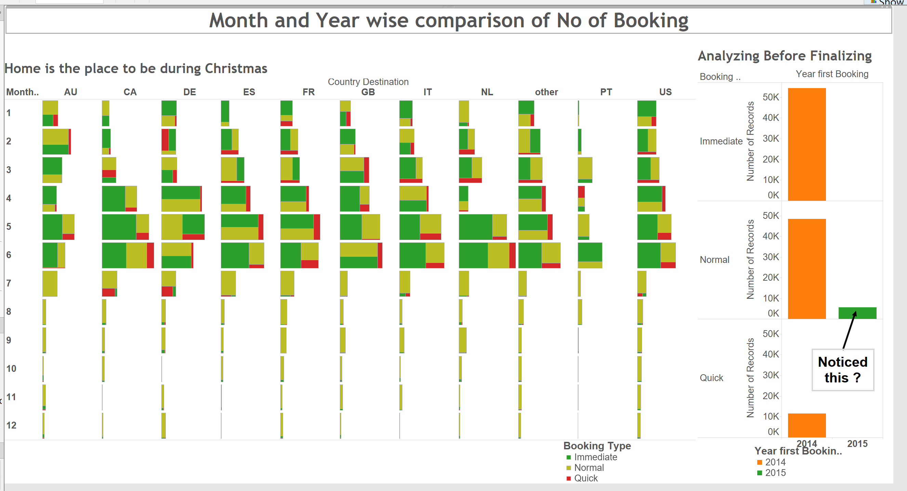
DATA BASED INSIGHTS-II
Notes:
- The left plot shows the number of bookings across month and year. Also we have done color coding to show the BookingType – Quick, Immediate and Normal.
Interestingly we found that almost all people travel in the first 6 month of the year and they don’t prefer to travel to new places during Thanks giving and Christmas. There could be two reasons. People want to stay with their families or people don’t prefer Airbnb for family trips during Fall and Winter.
- From the right plot, we can notice that in the year 2015, almost all the customers who have booked, that been of type – normal(6 or more days to book) – blogging and customer UI experience is very important

Slide 11
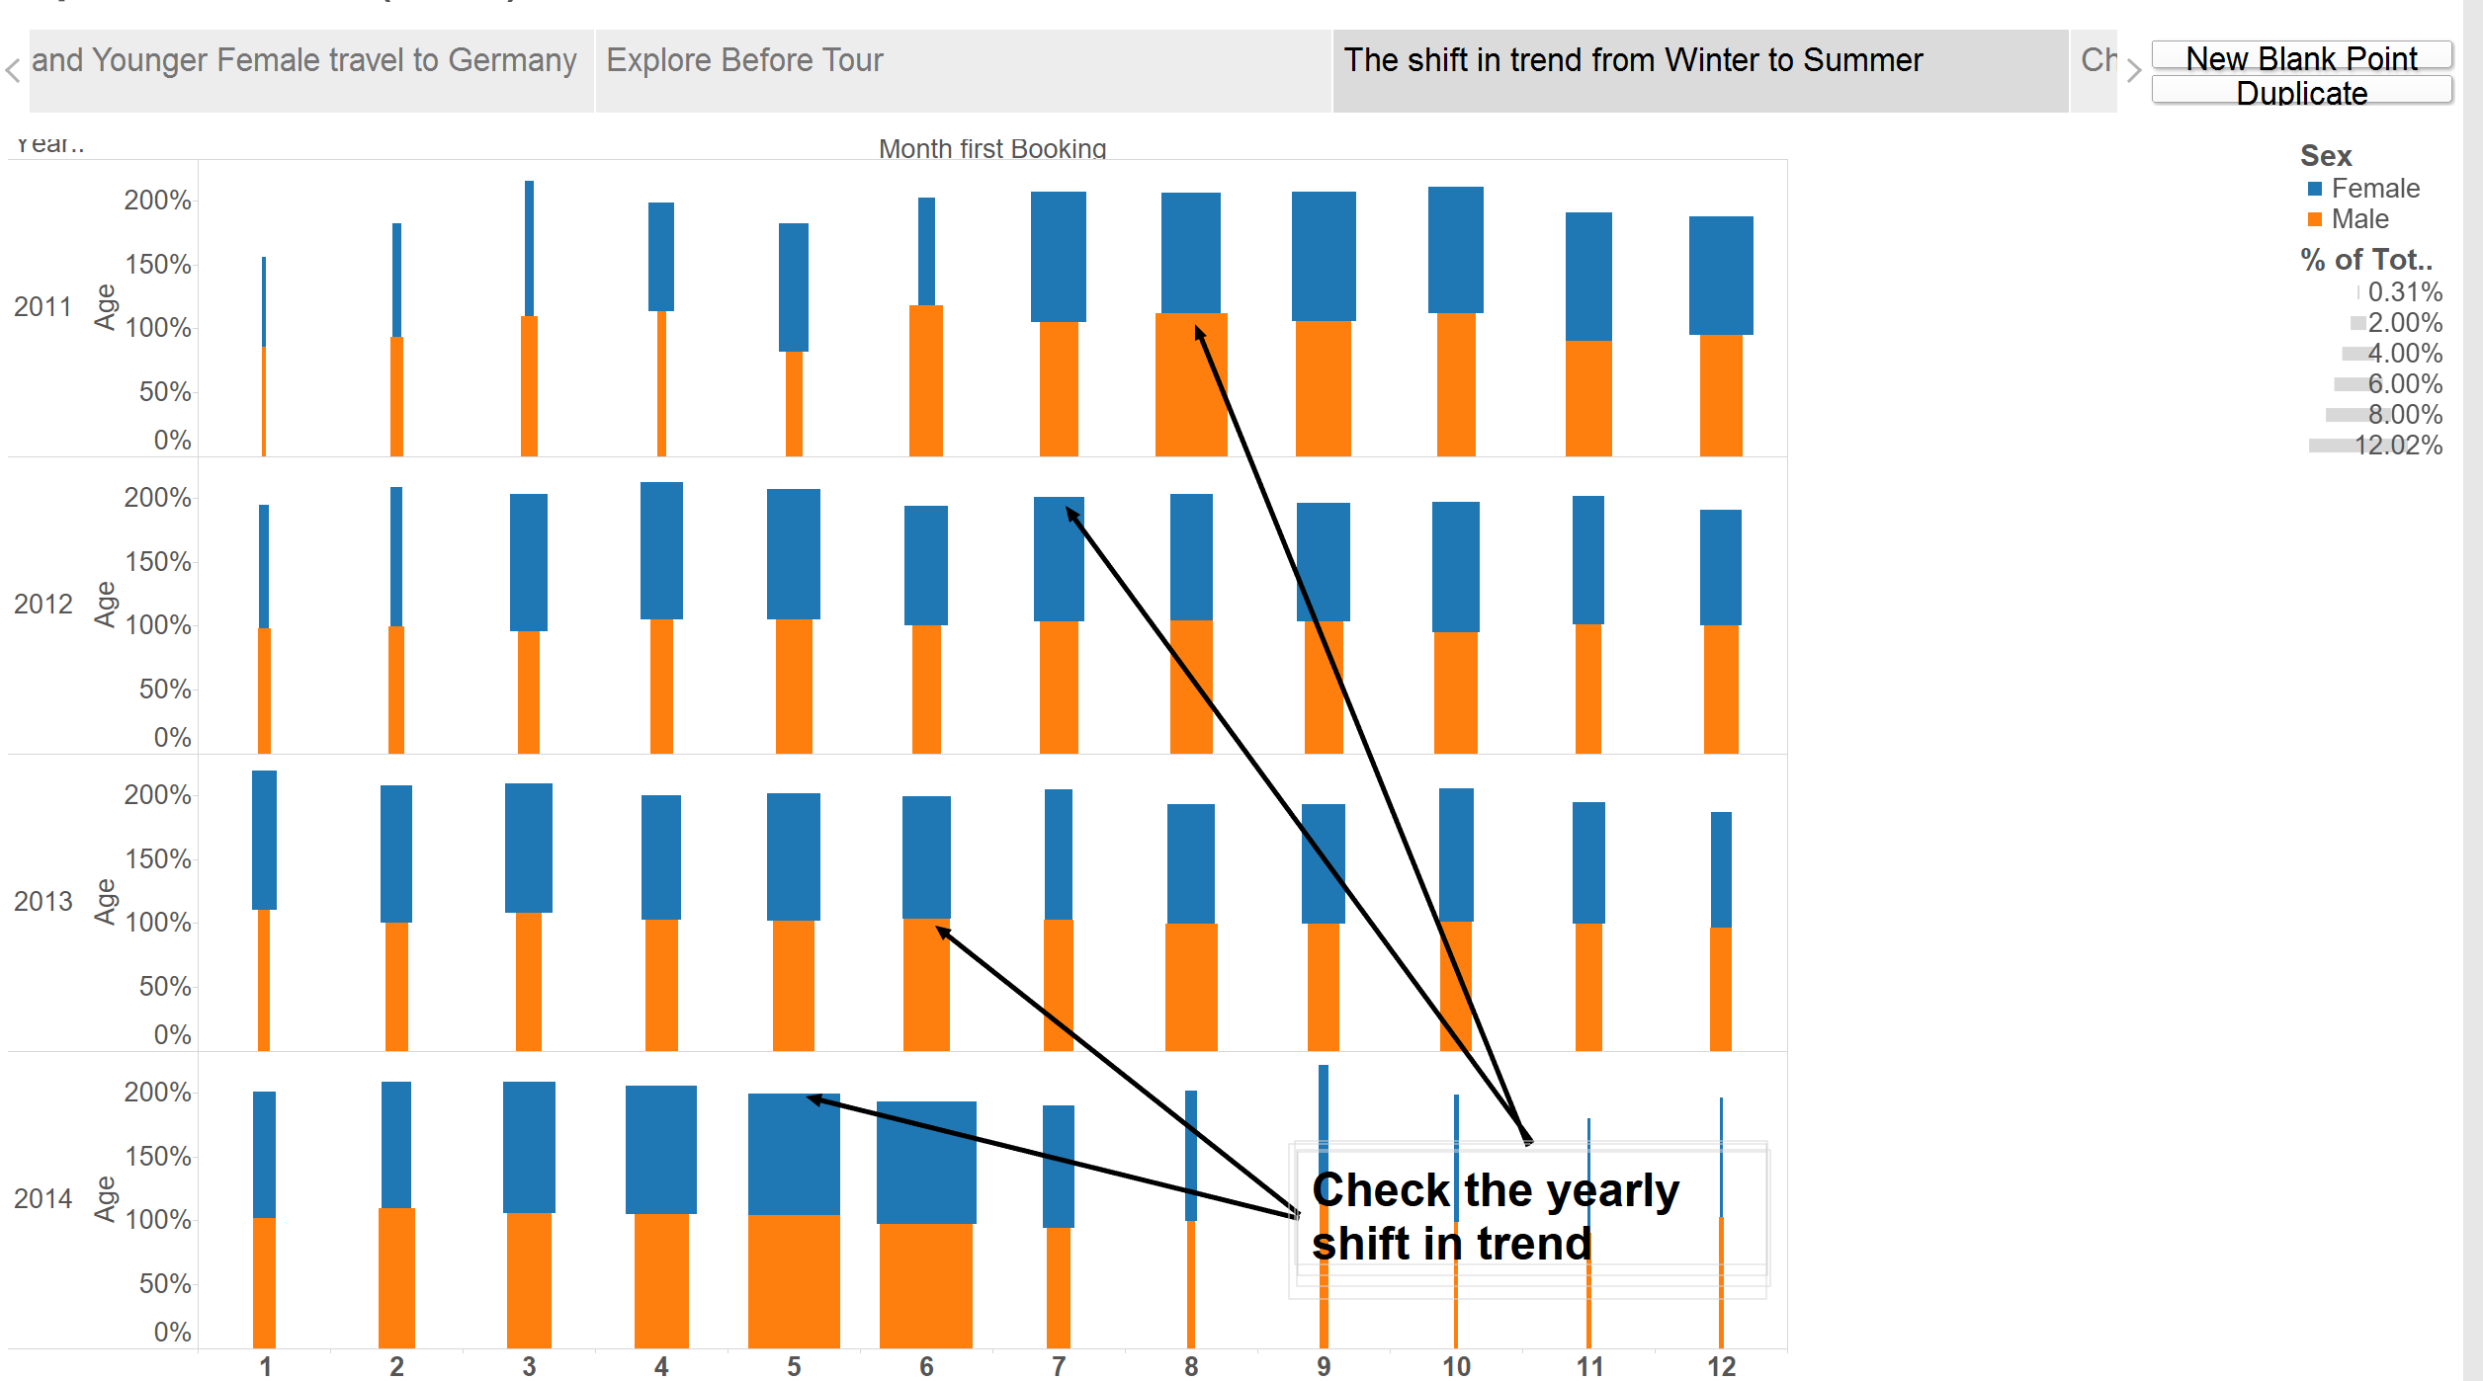
Data Based insights - III
Notes:
Trend Analysis
We can see there is a shift in the trip pattern. If you notice, in 2011, most of the people travelled in August and September, and in 2012, they travelled in July, in 2013 they travelled in June and 2014, people travelled in April and May. This transition is important as far as future trend is considered. Based on the future predictions, marketing department can target the customers based on the months/seasons.

Slide 12
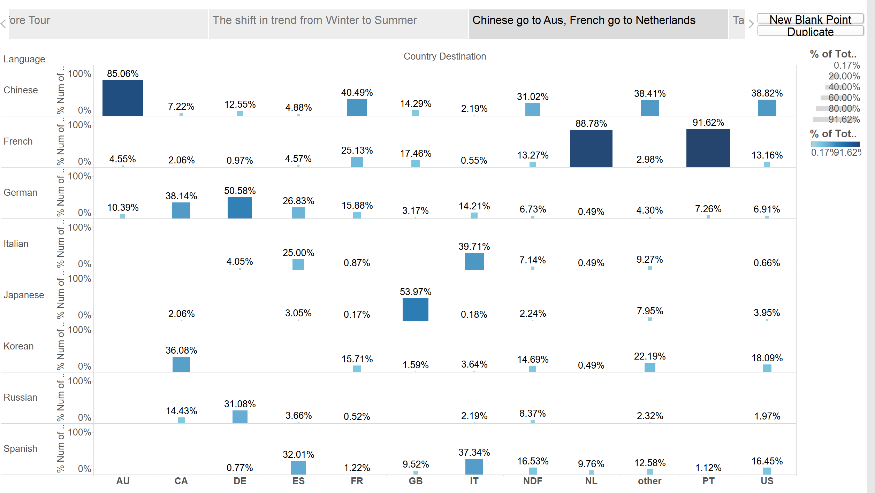
DATA BASED INSIGHTS - III
Notes:
Understanding correlation between Country destination and Language
Below insight tells that Chinese talking people go to Australia and French speaking people go to Netherlands and Portugual. Since most of the records had English as their preferred language, we have excluded the English speaking people to arrive to the below chart.

Slide 13
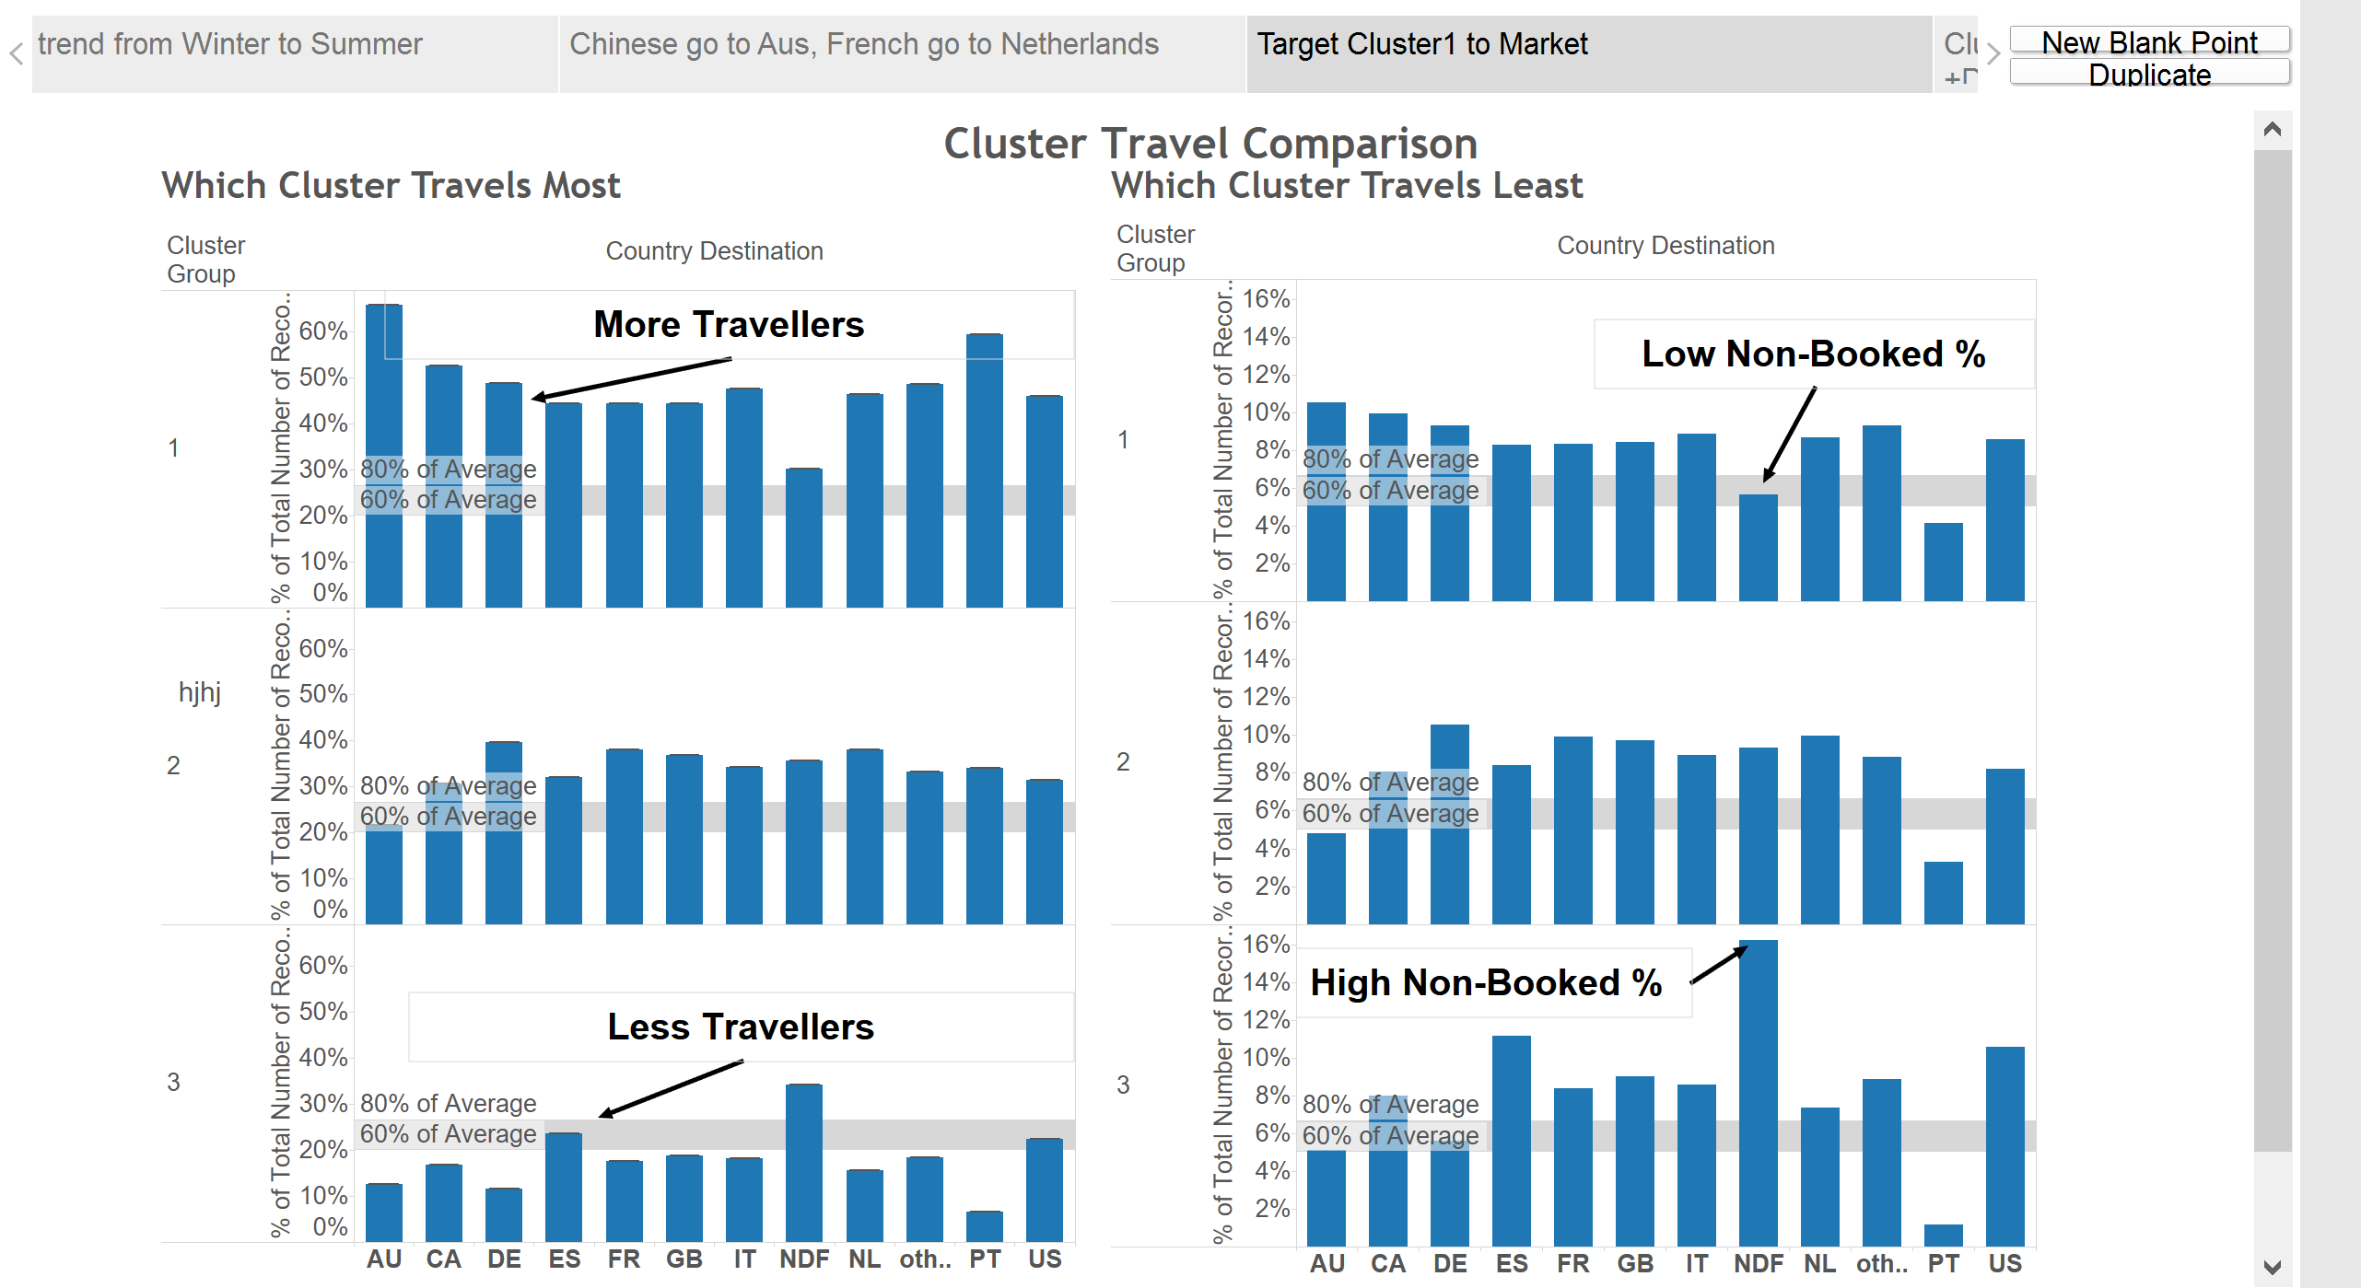
Clustering in R
Notes:
PAMK Clustering
Owing to a large number of dummy variables and null, medoid provides a better algorithm when compared to mean based
This combines the advantage of hierarchical clustering that initial clusters need not be given. A perfect number of cluster is chosen based on the distribution in n –dimensional space

Slide 14
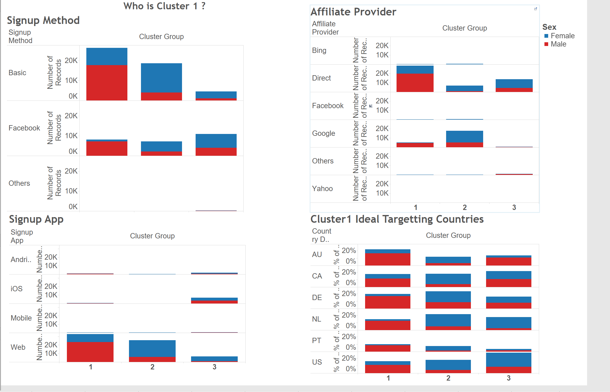
CLUSTERING in R – II
Notes:
Who are the Cluster1 Customers
Hence we plotted cluster data against signup method, the mode of sign up, the countries they prefer and sign up app.
It is found that cluster1 people are users who use their own email id to sign up, use desktop to login, don’t use google or bing as search engine and mostly travel to Australia , Canada and Germany.

Slide 15
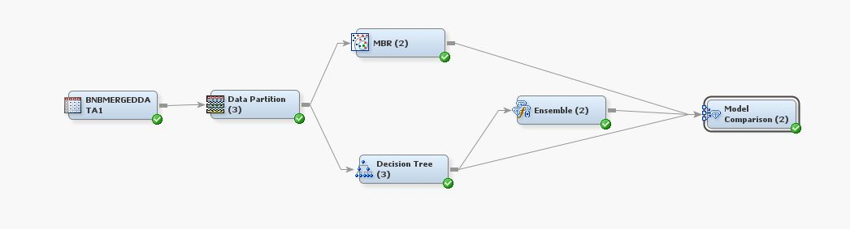
PREDICTIVE MODELLING – FULL DATA SET

Slide 16
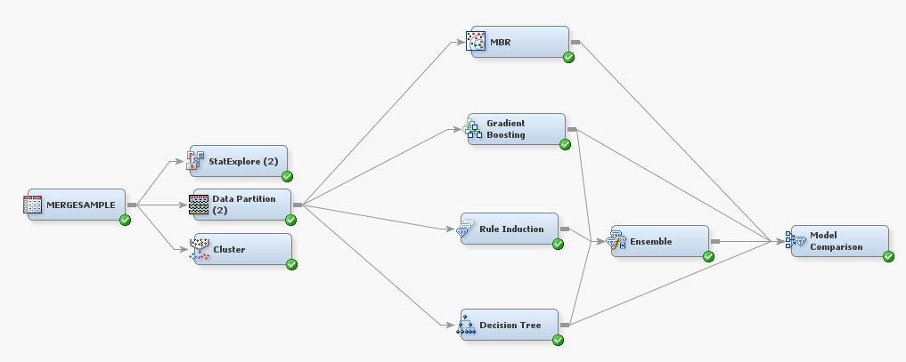
PREDICTIVE MODELLING – STRATIFIED RANDOM SAMPLE

Slide 17
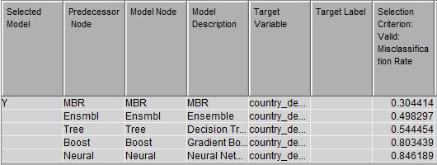
MODEL Comparison

Slide 18
COMPARING
Model/Attribute | Accuracy | True Positive Rate
Base Model | 66%
Full dataset + MBR | 94.5% | ~ 30%
Stratified Random Sampling + MBR | 92.5% | ~ 50%

Slide 19
Graphical COMPARISON OF TPR – BY Country

Slide 20
BUSINESS SIGNIFICANCE
By accurately predicting where the New User will book their first travel, Airbnb can
Target potential customers at reduced cost and increased Lift
Share a more personalized content
Decrease the average time of their first booking
Improve demand forecasting

Slide 21
QUESTIONS?

